Slide 2
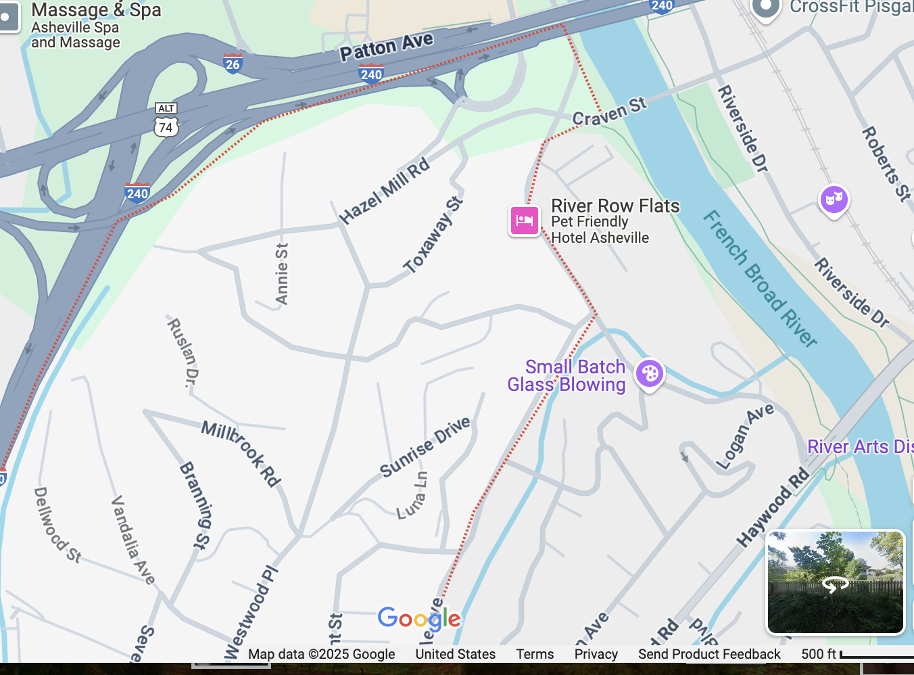
Project Area of Concern

Slide 3
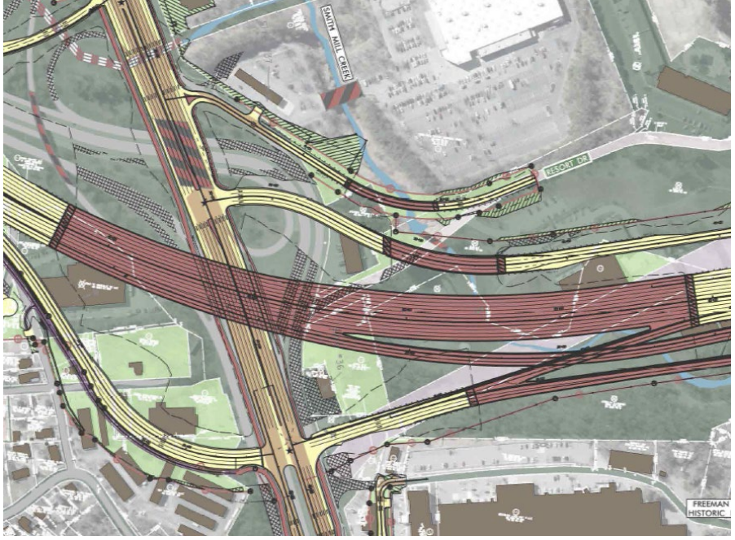
Best available map of Patton Ave. Flyover
Light green property acquisition
NCDOT.gov
I-2513BD Update Nathan Moneyham, PE Division Construction Engineer 2/20/2025

Slide 4
Project site for “flyover launch” and proximity to housing
(former FedEx parcel, current debris collection site)

Slide 5
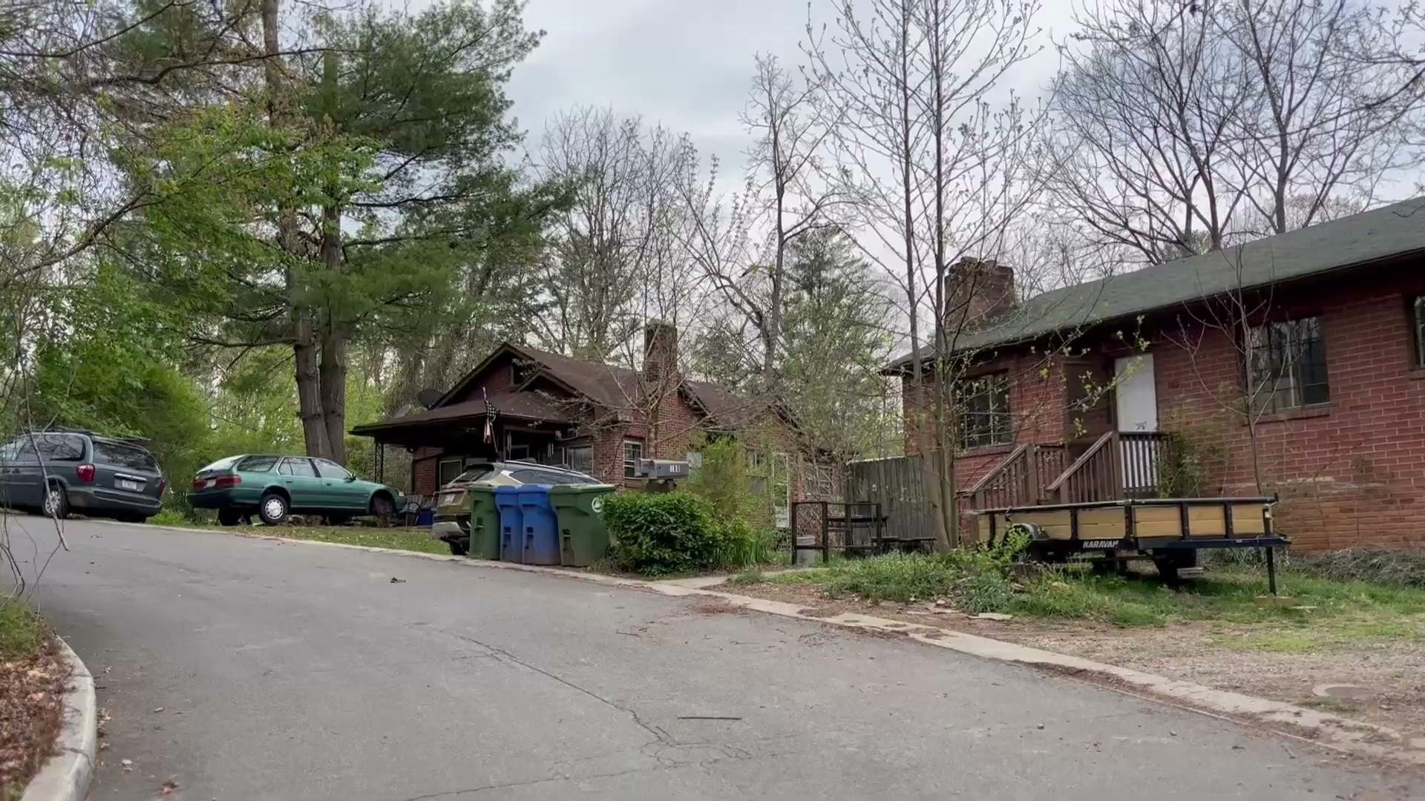
Corner of Richland and Hazel Mill

Slide 6
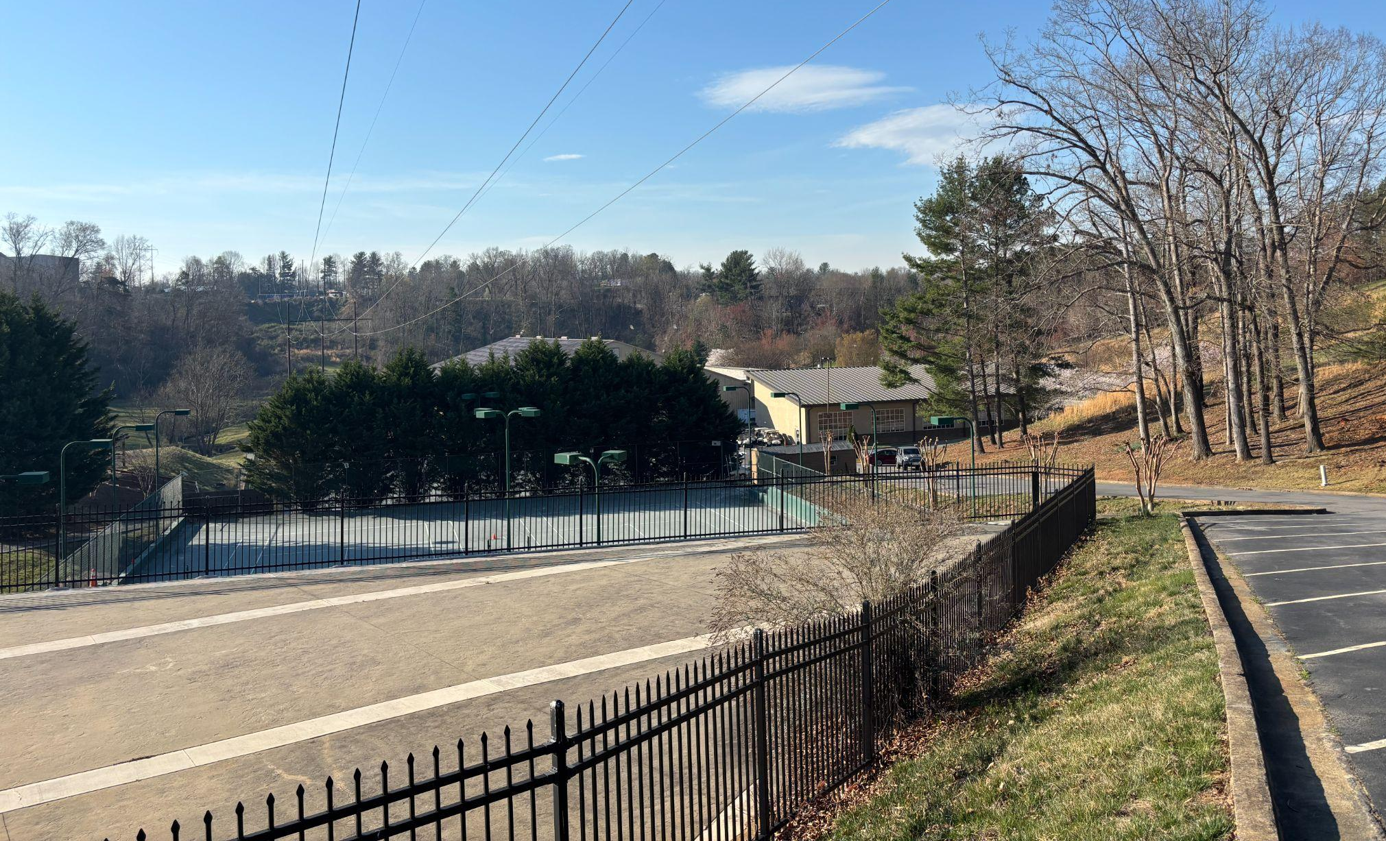
Looking back from high point @ ARC property

Slide 7
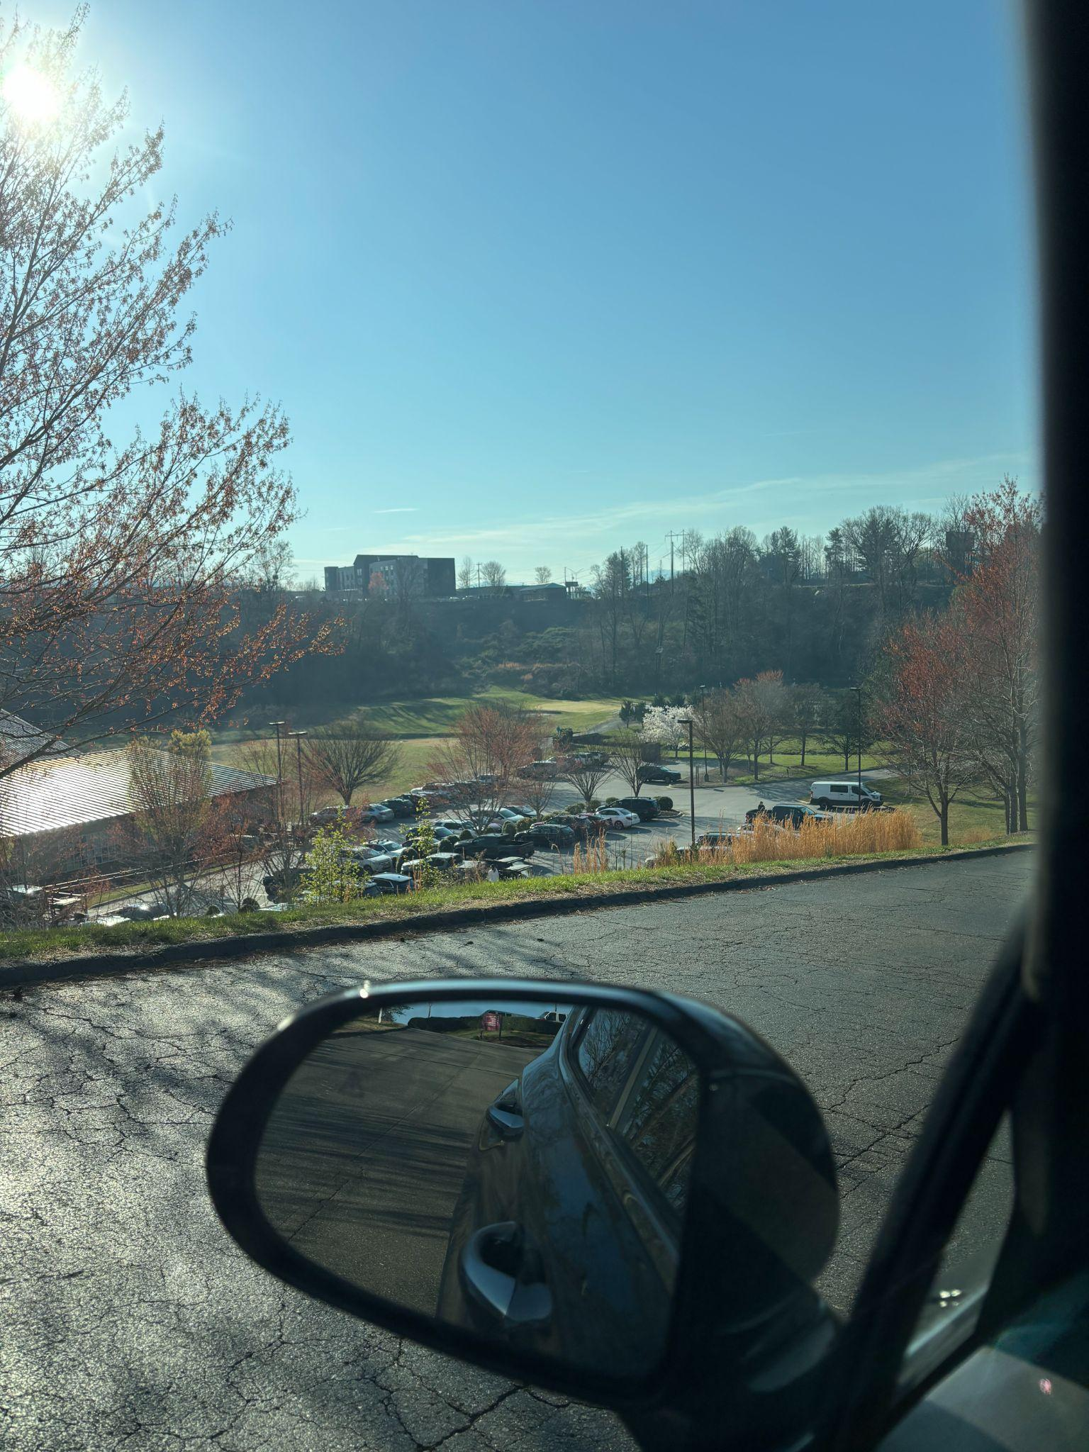
Valley @ ARC

Slide 8
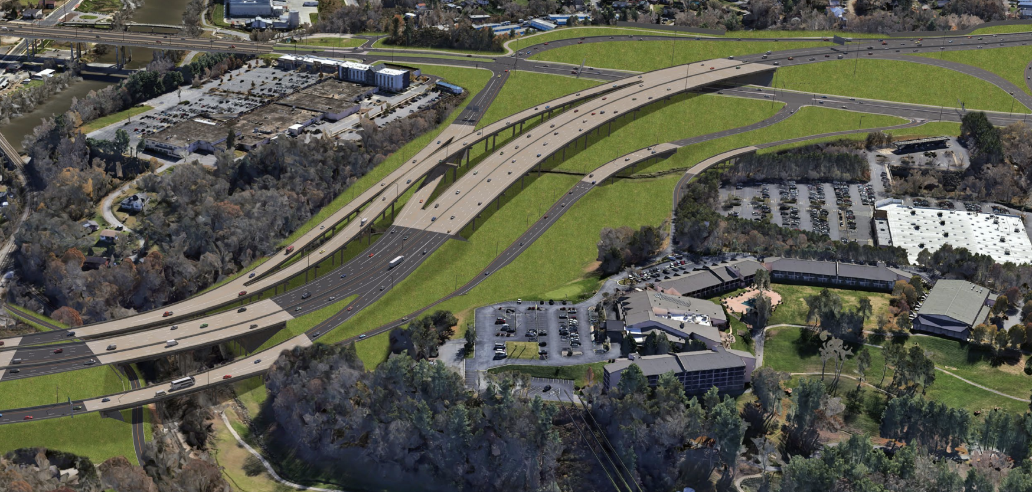
“Patton Flyover” per NCDOT presentation 2/25/25

Slide 9
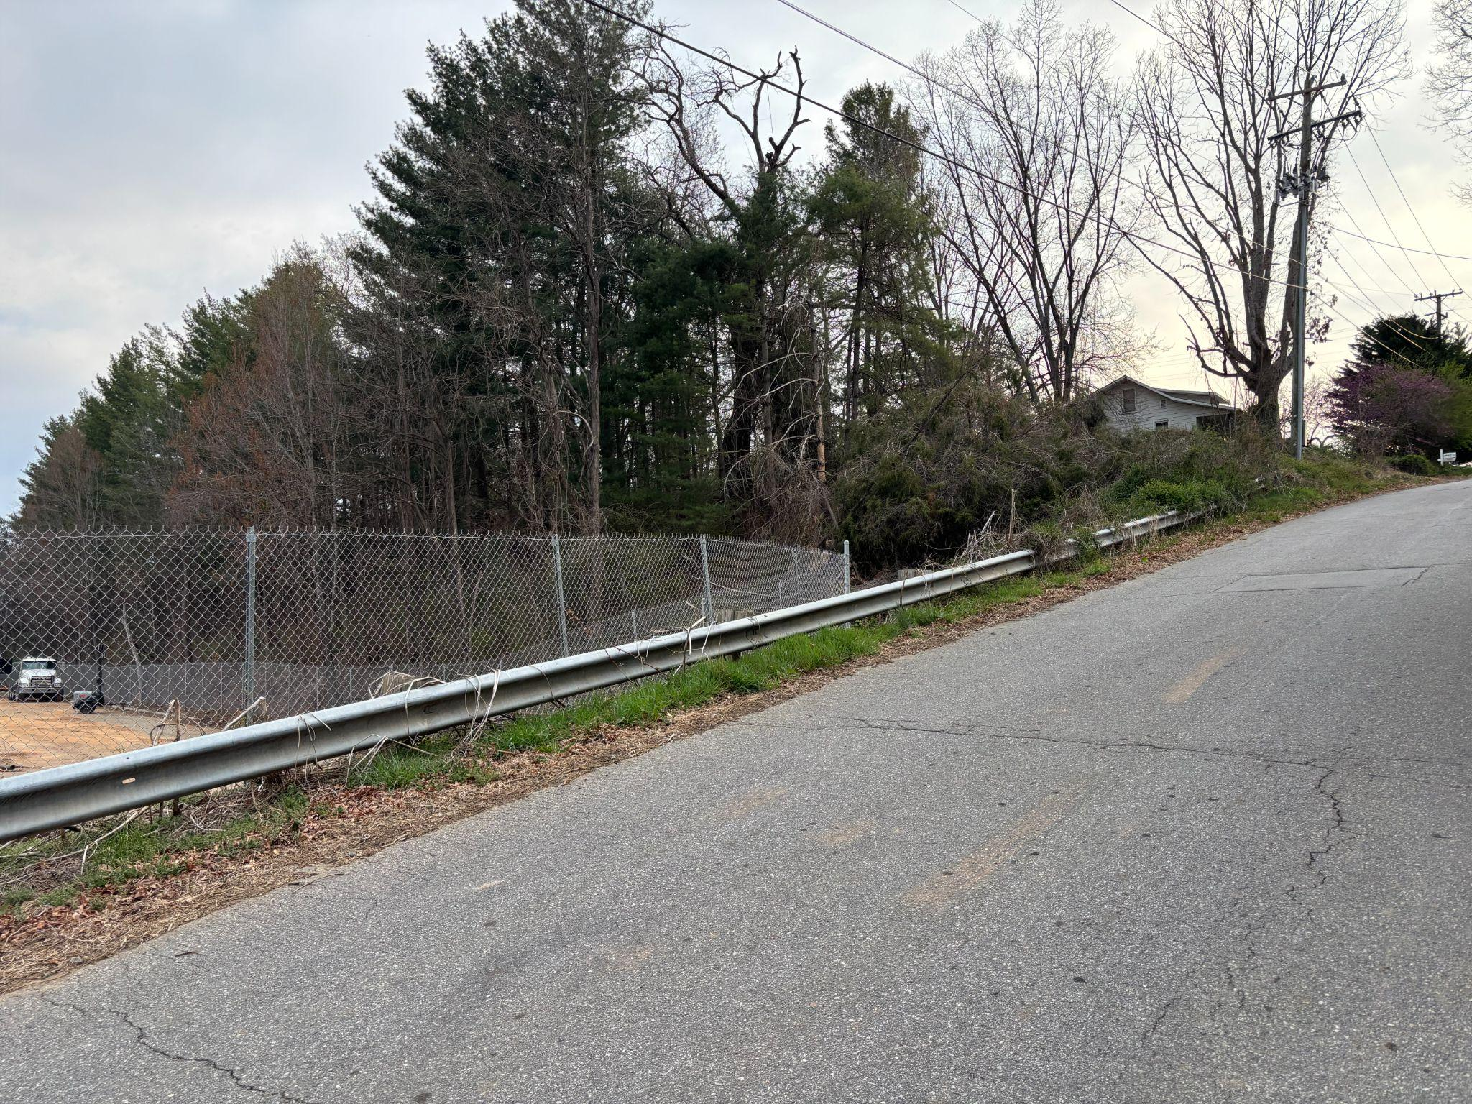
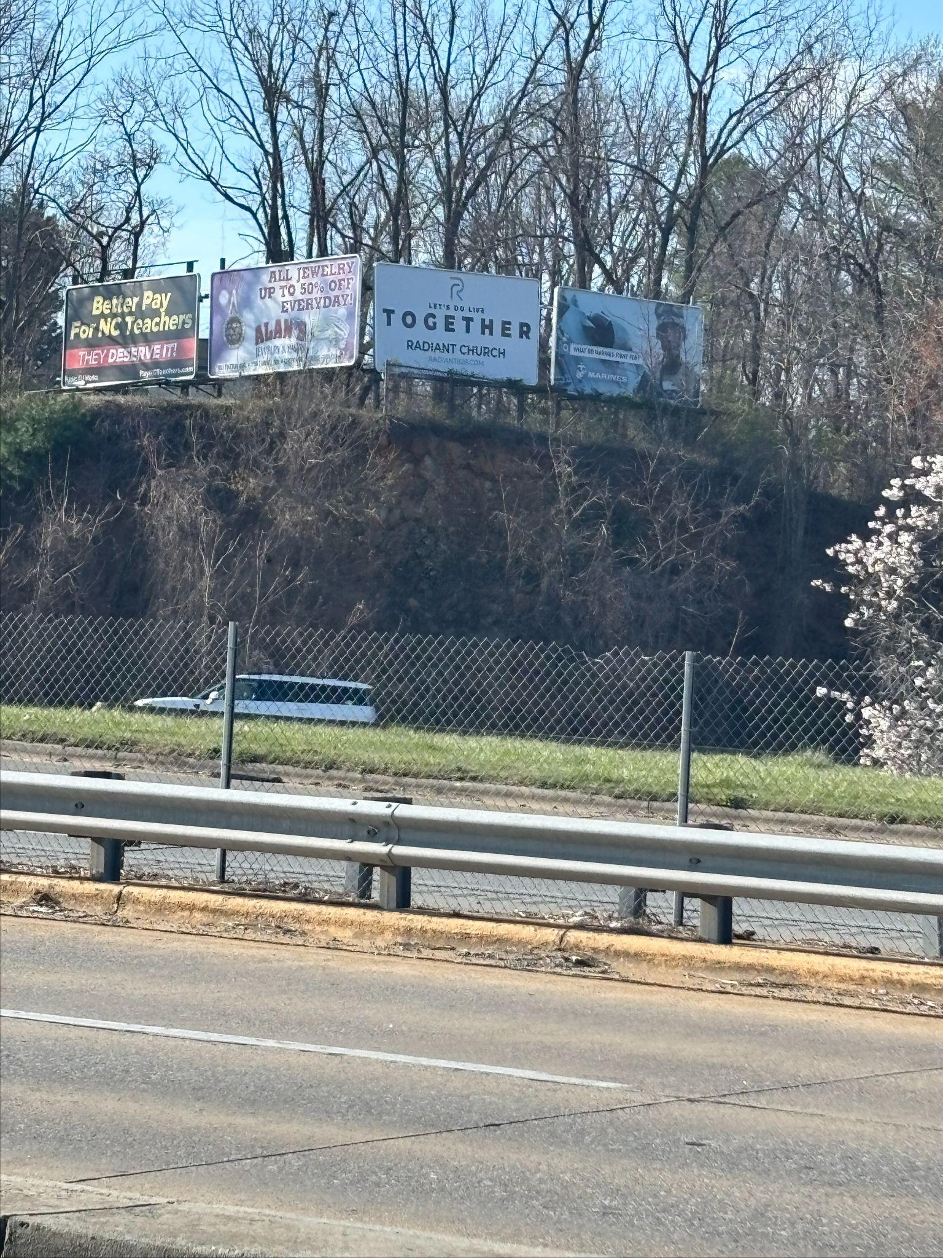
Annie St from Street View and from Resort Drive

Slide 10
Westwood Place - Hazelmill Rd (WARNING! Blind Corner)

Slide 11
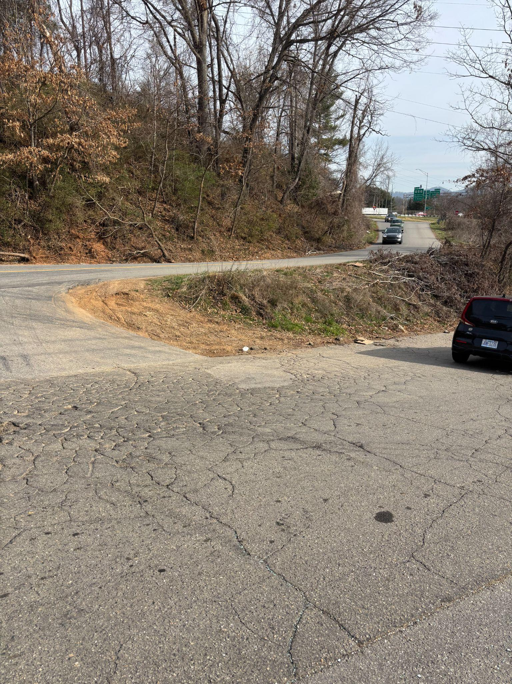
Shape of the Craven Connector
(confusing, traffic enters the wrong way)

Slide 12
Truck turned over on Craven Connector Jan. 2023

Slide 13
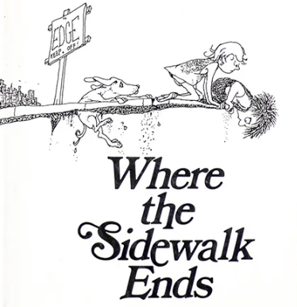
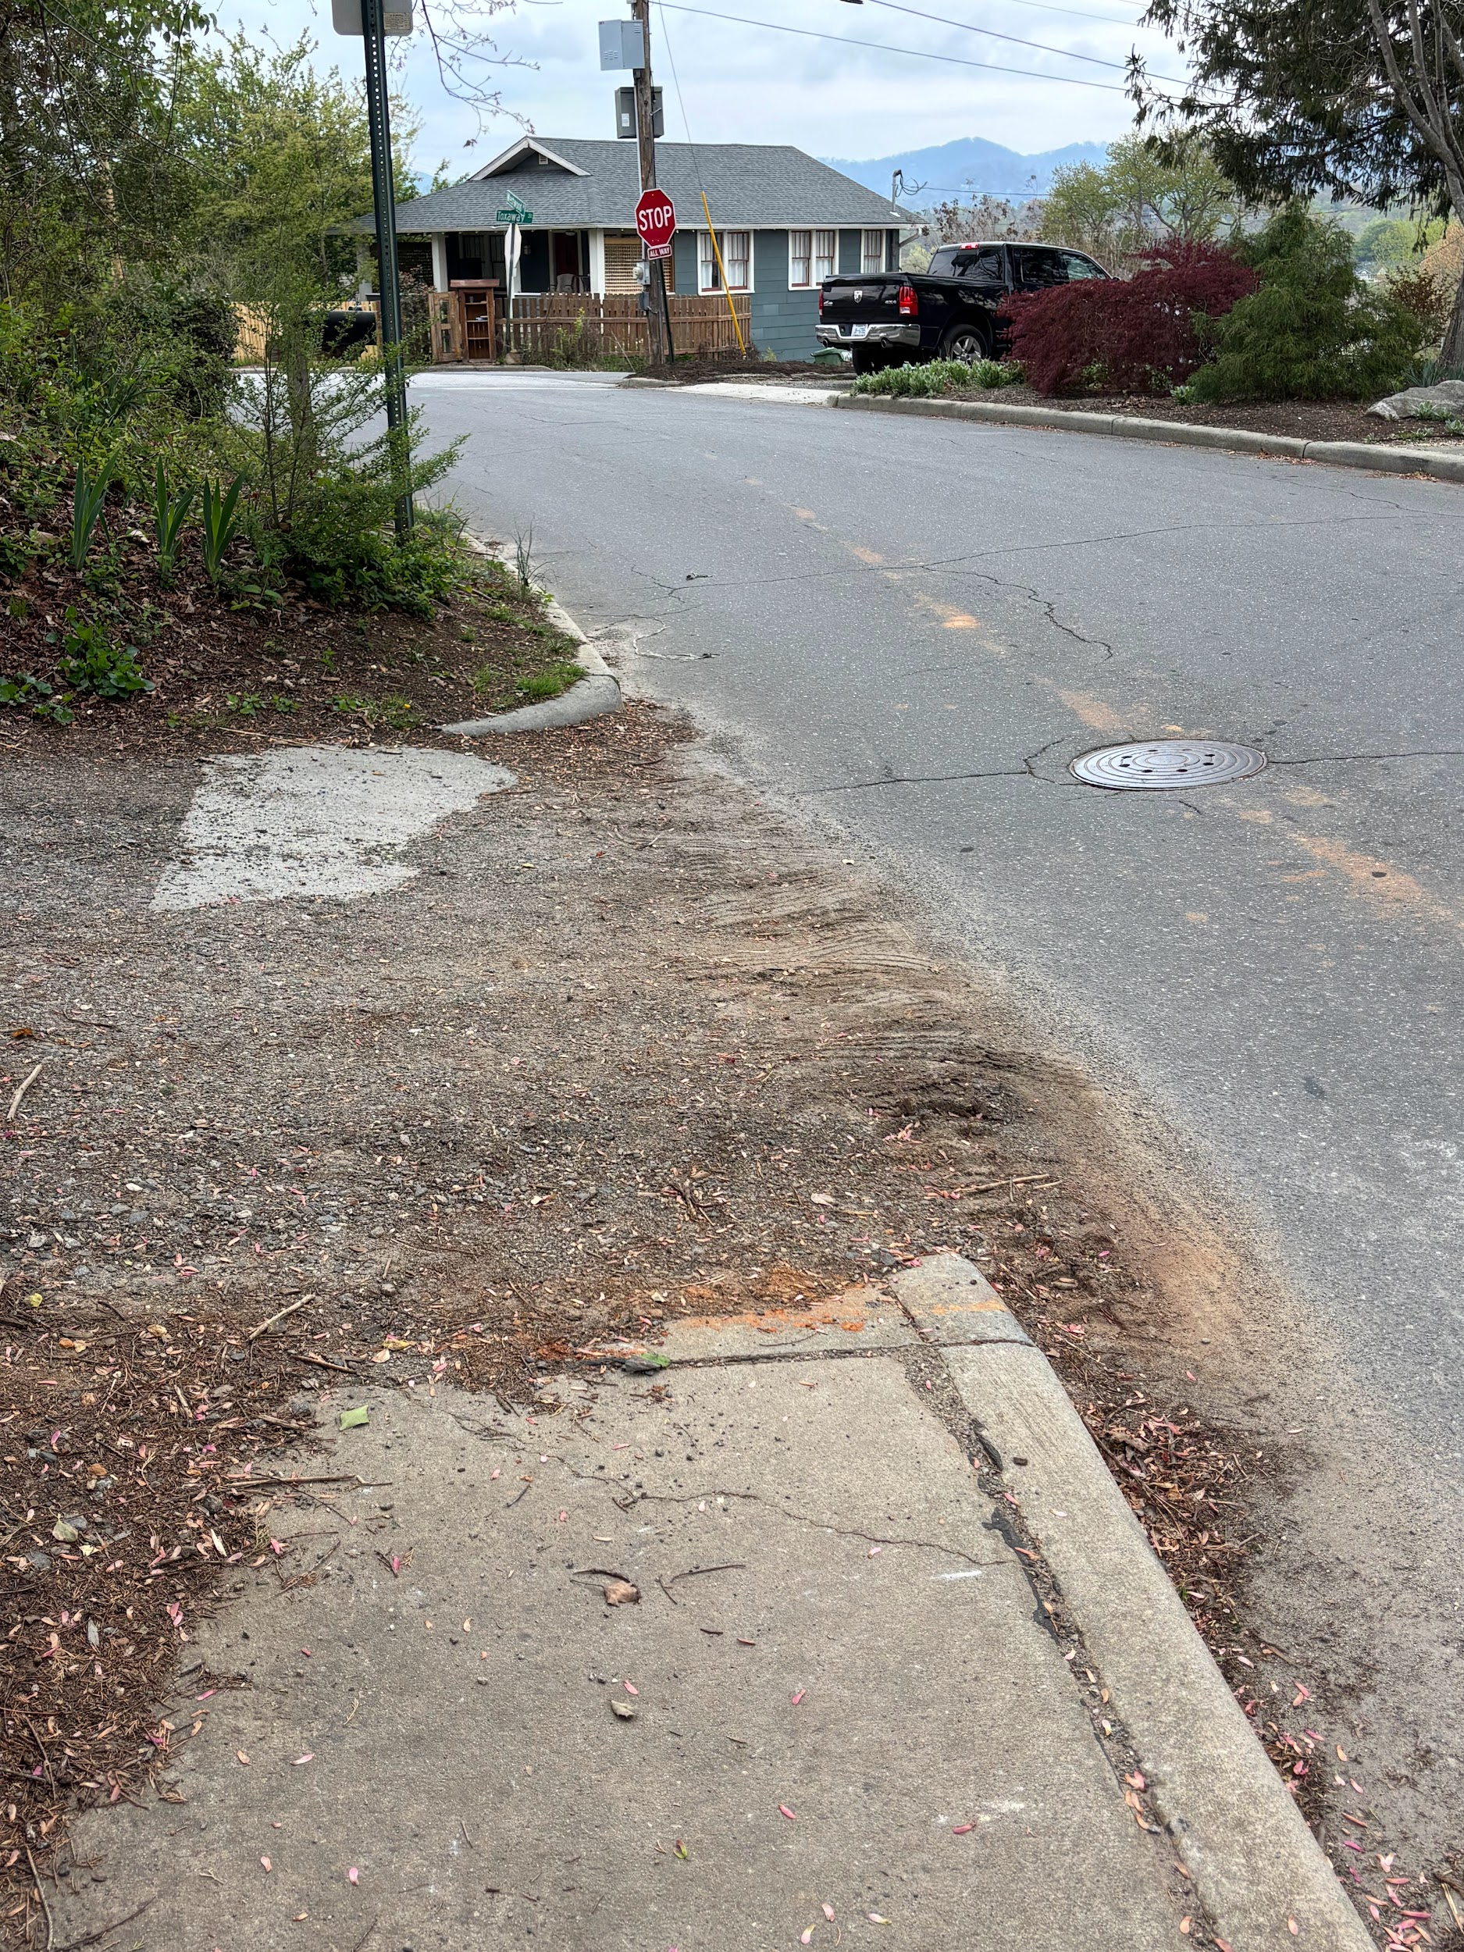
Toxaway and Westwood Pl.
and again at Craven Connector limiting access to multimodal infrastructure.

Slide 14
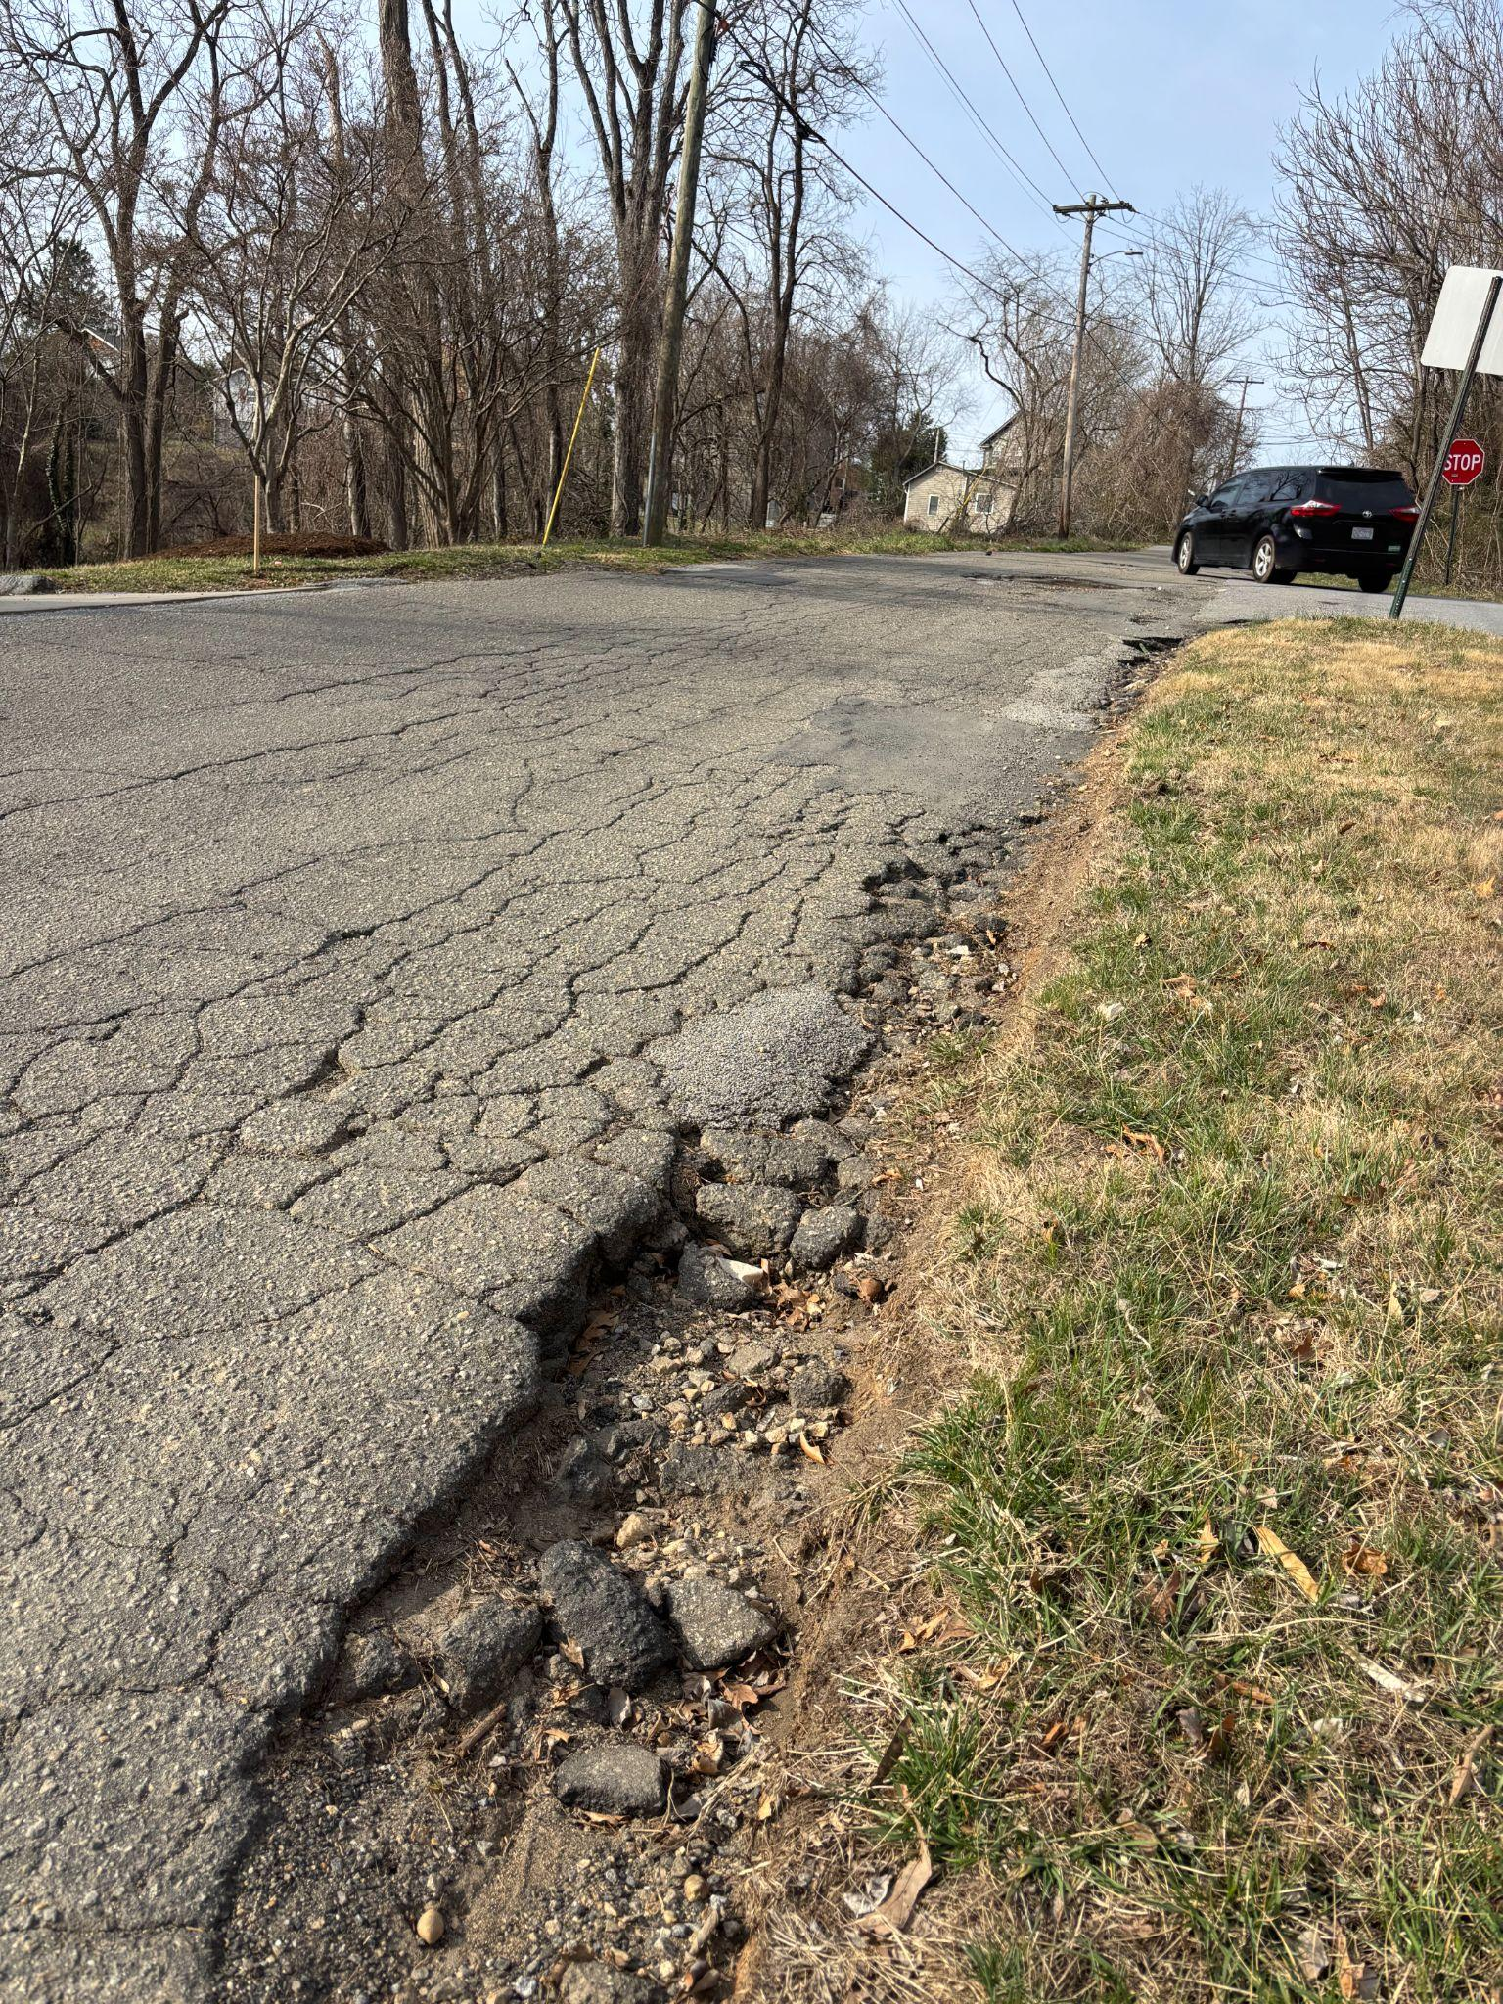
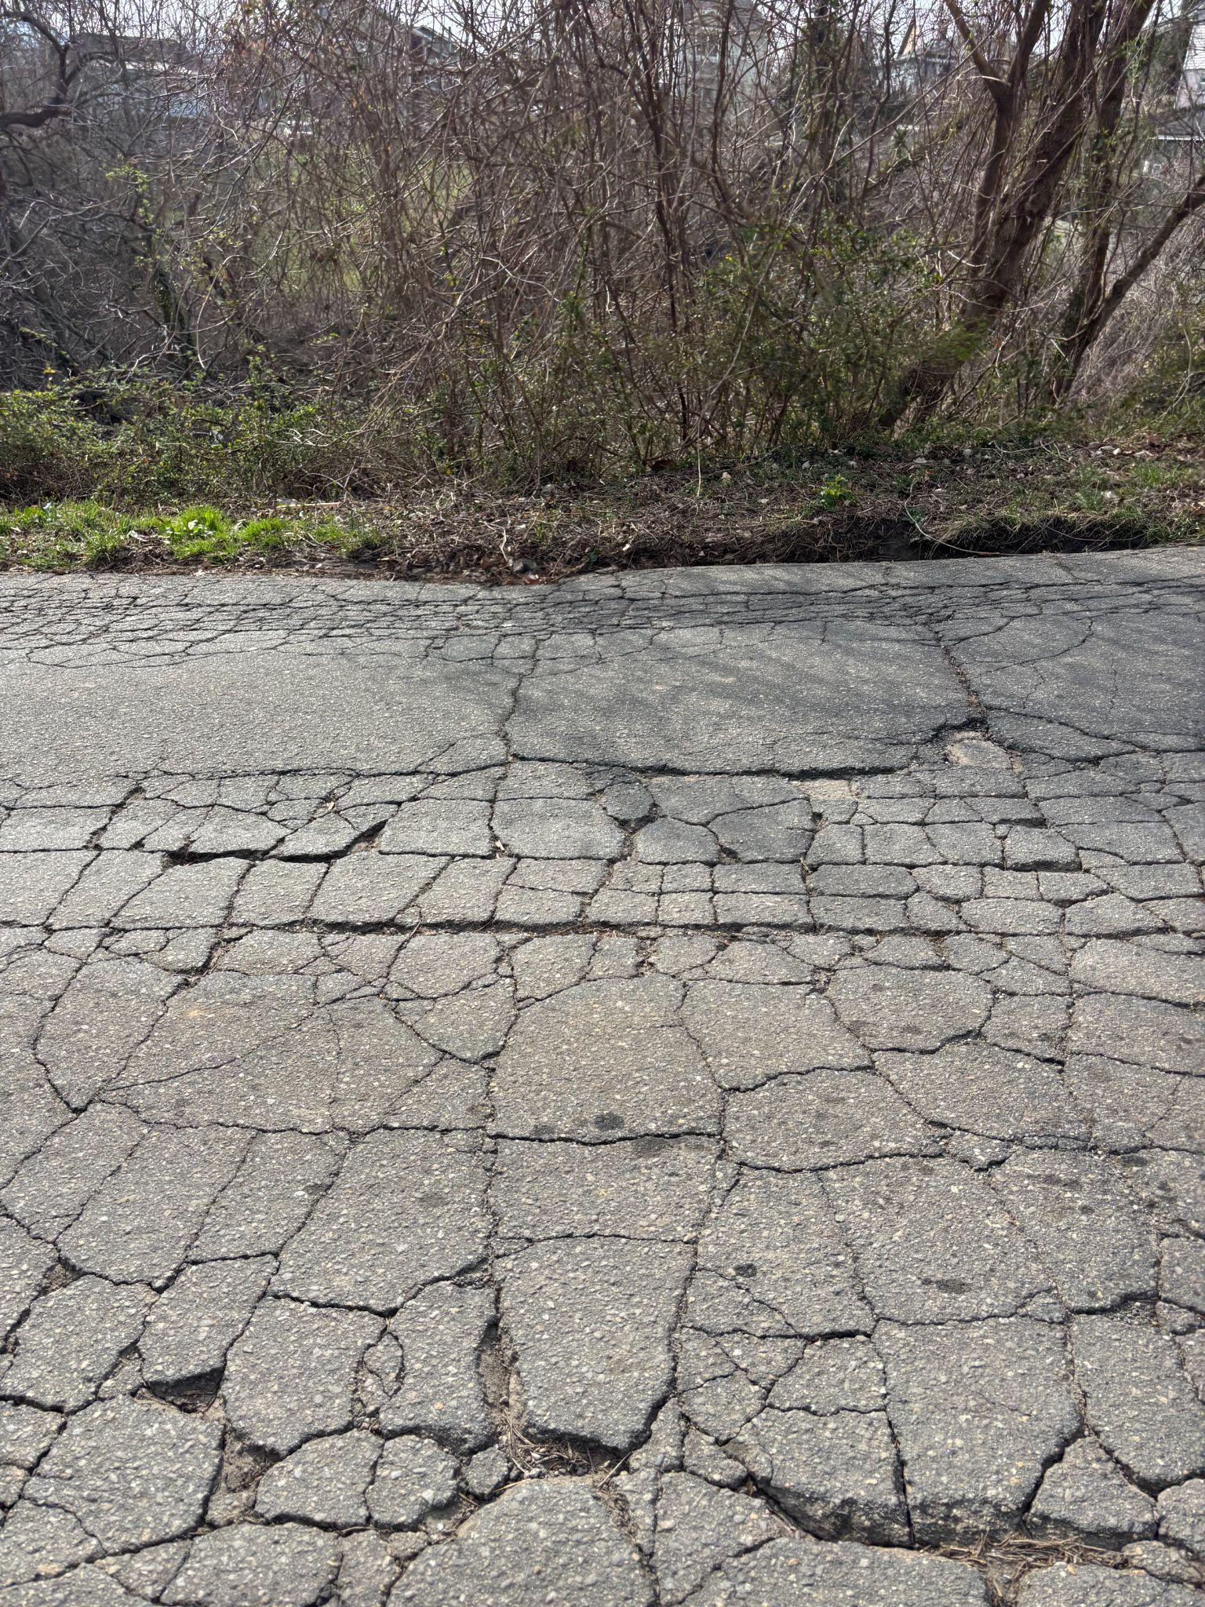
Need for resurfacing and pedestrian crossing Hazel Mill Rd.

Slide 15
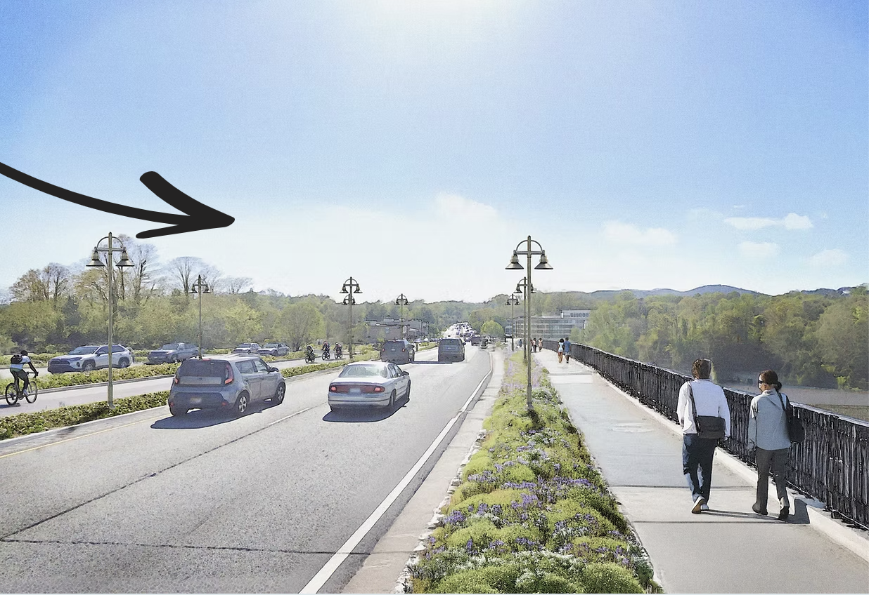
Welcome to
East West Asheville
We can’t walk here!

